Slide 1
ACOWA: App-driven Component-based device for Optimizing Water quality data Accuracy
By: Shaun Fernando
2021

Slide 2

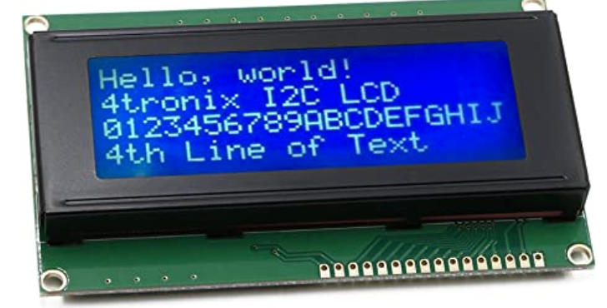
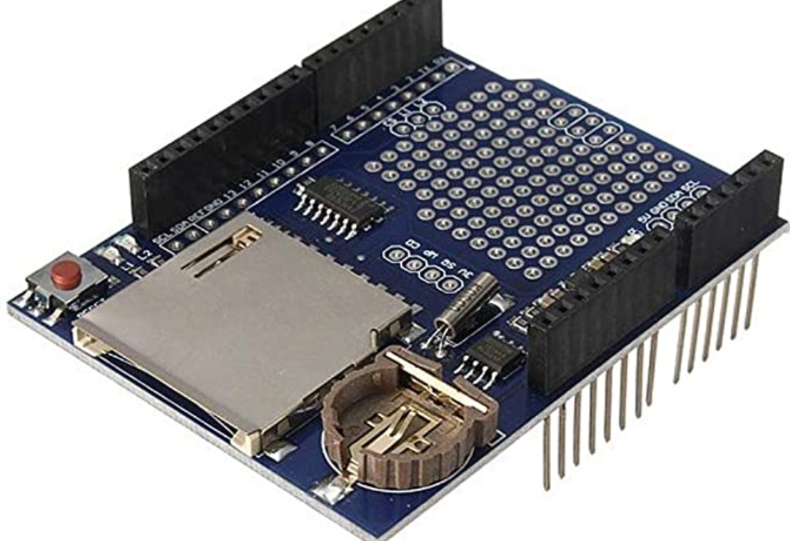


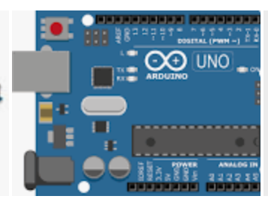
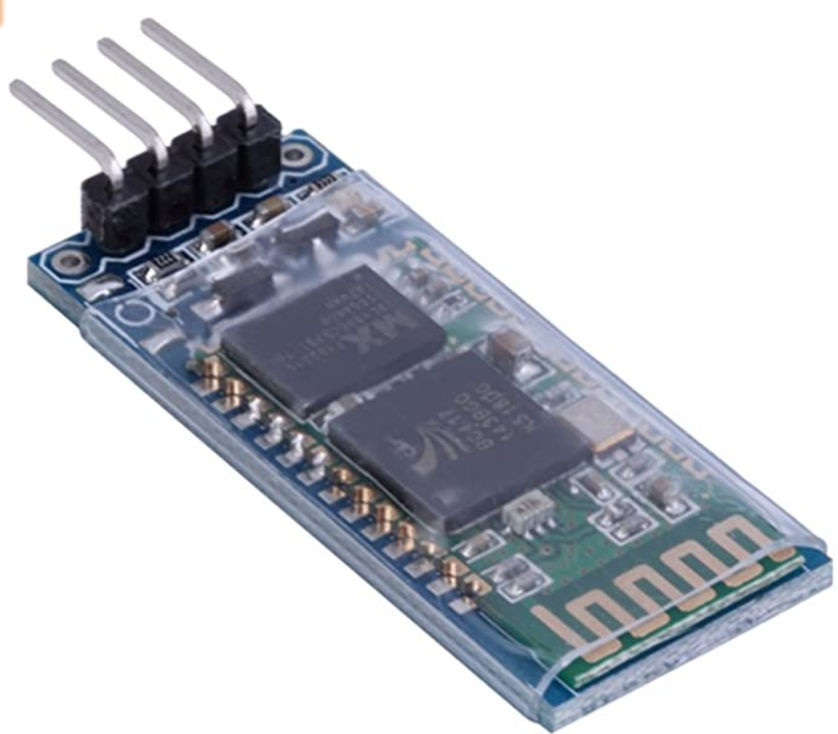

ACOWA - Component Diagram
User
base
Water Sources
Component based tier to Collect Data, Store and Transmit
Presentation
Tier

